Slide 2
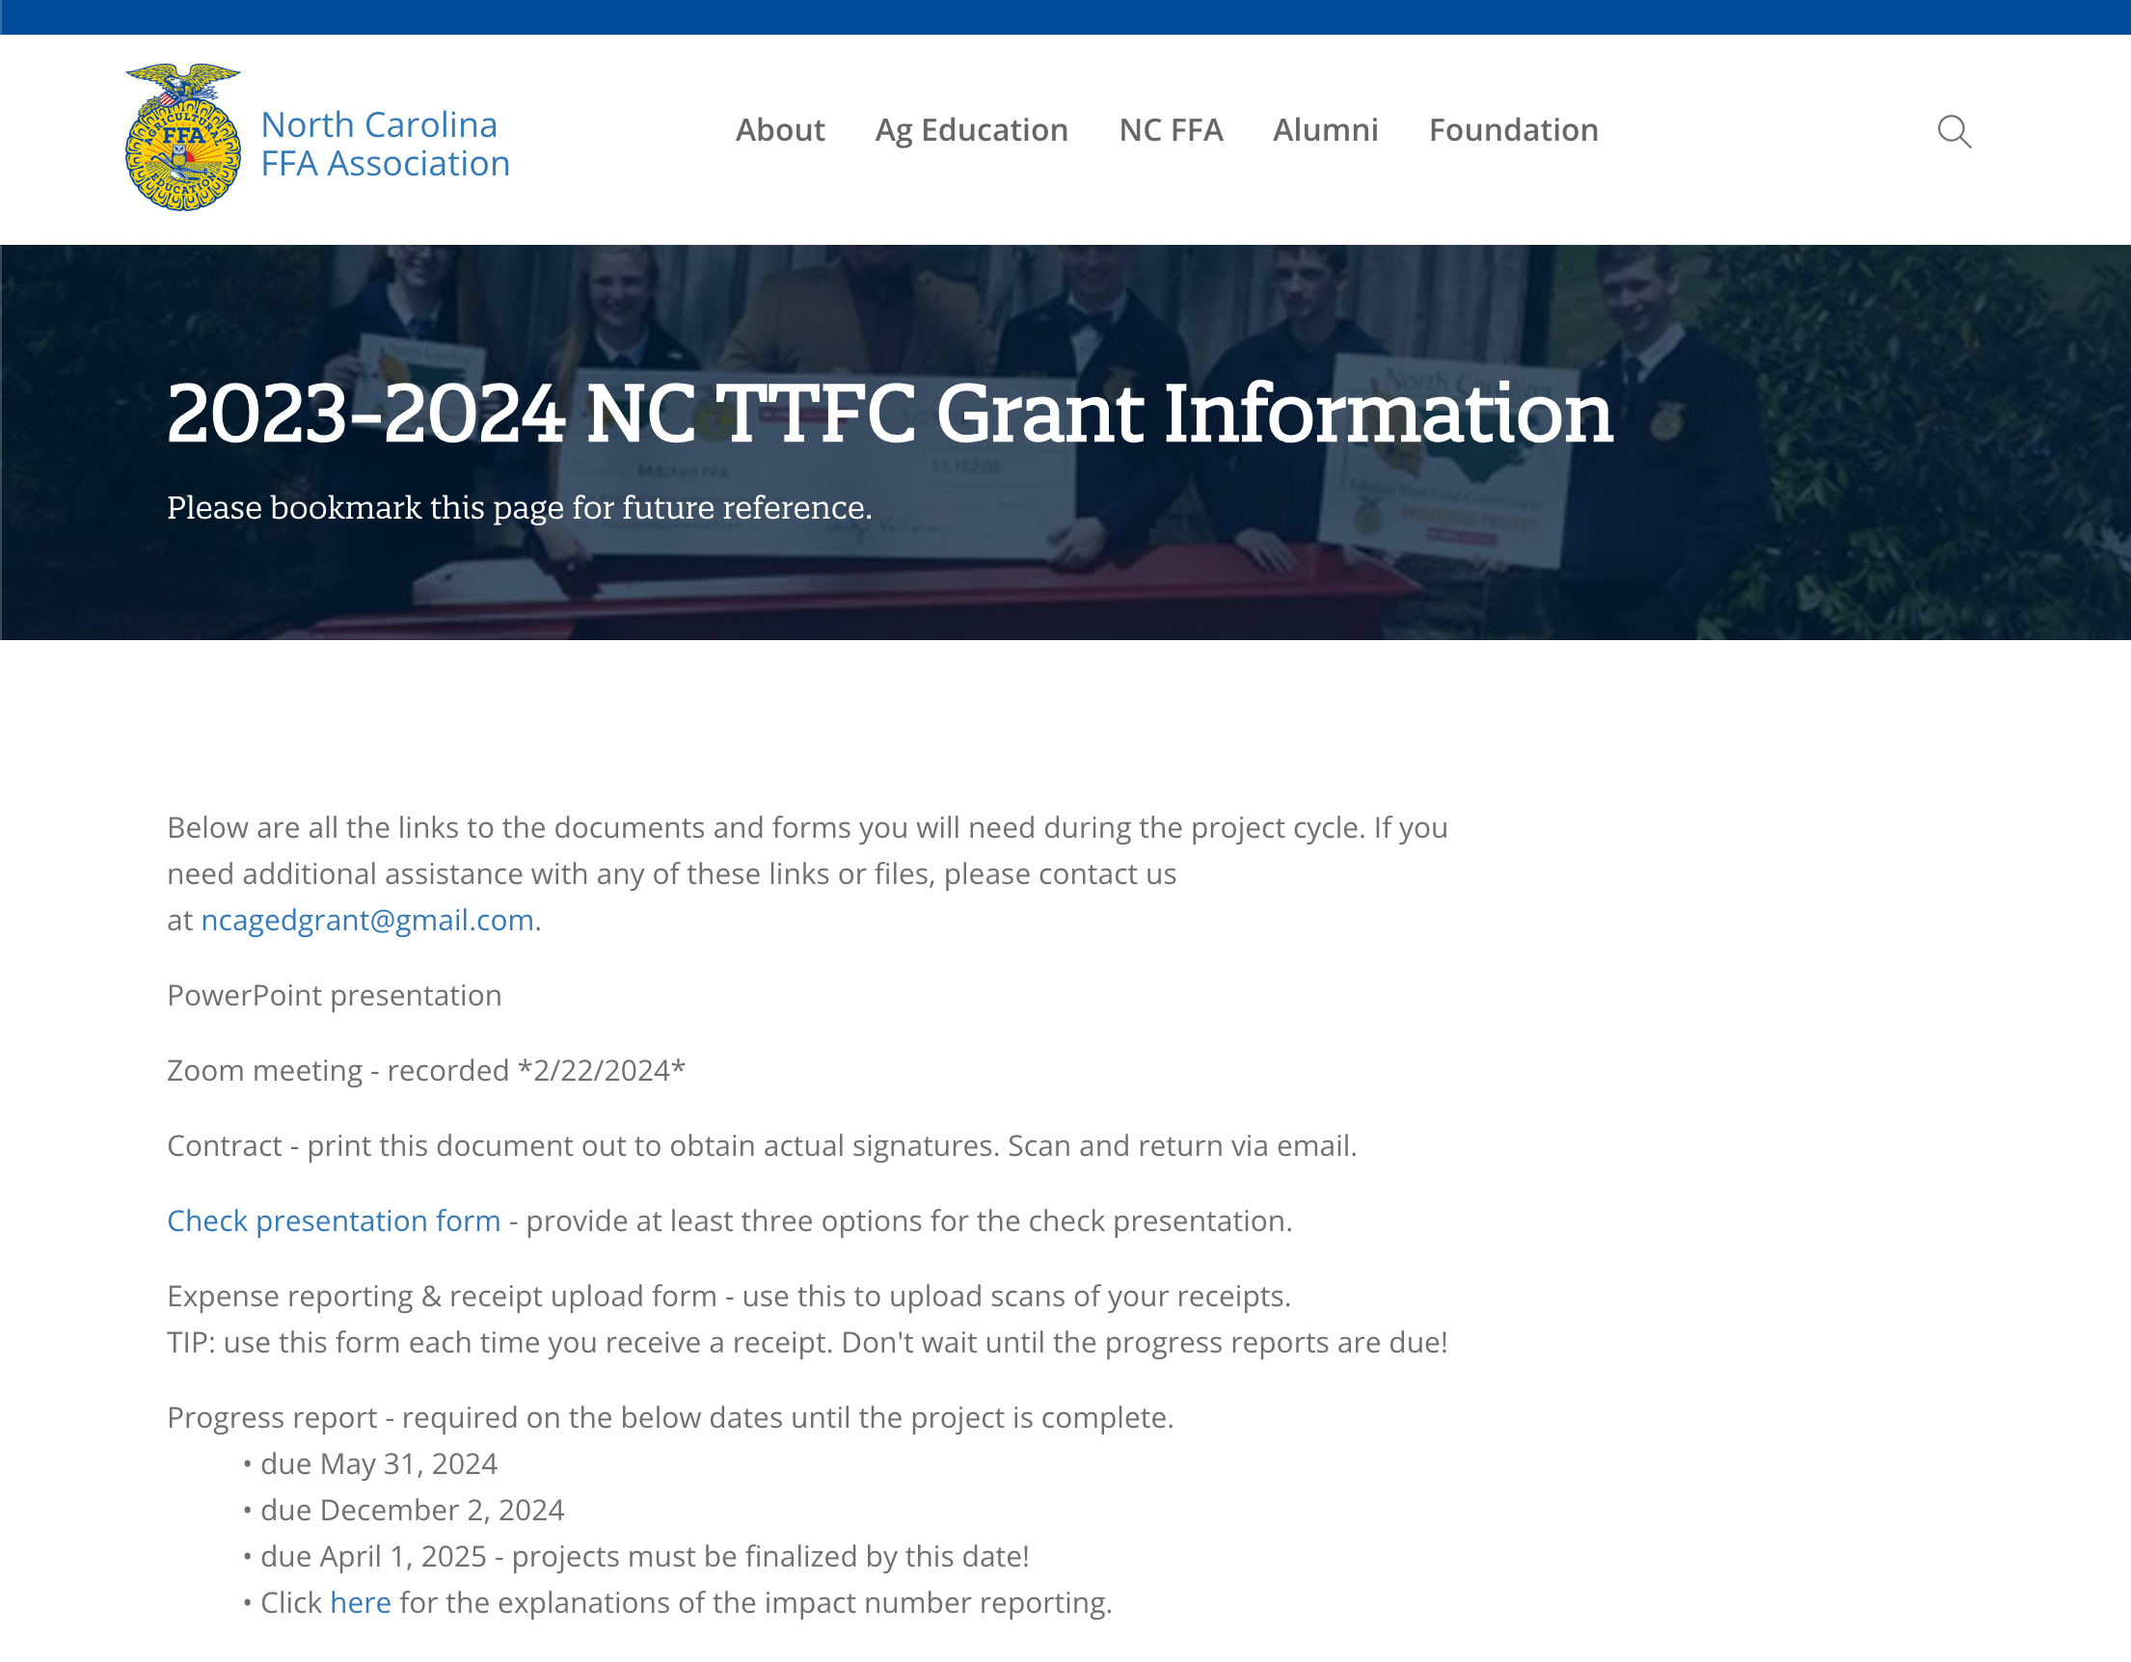
https://ncffa.org/2023-2024-nc-ttfc-grant-information

Slide 3
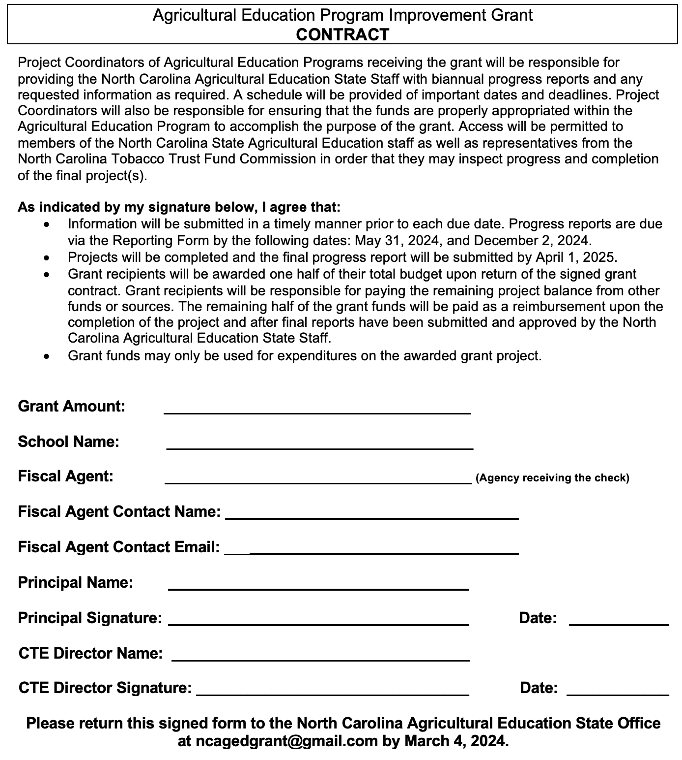
Fiscal agent should be the entity that will receive the payment.
Both signatures are required. No typed names or pictures of signatures are allowed.

Slide 5
Grant Payments
Half of the total amount of the grant will be paid at the beginning after the contract and check presentation information is submitted.
Grant recipients will be responsible for paying the remaining project balance from other funds or sources.

Slide 6
Grant Payments
The remaining half of the grant funds will be paid as a reimbursement upon completion of the project and after final reports have been submitted and approved by state staff.
Please plan appropriately with your local school and/or school system administration.

Slide 7
Fund Distribution
Joshua Bledsoe will work with advisors and bookkeepers for all financial forms.
Please notify your bookkeeper/fiscal agent contact that Joshua Bledsoe will be in contact with them soon.
We will notify you and the fiscal agent when payment has been approved.

Slide 8
Progress Reports
All grantees must complete all progress reports on time.
Due by May 31, 2024
Due by December 2, 2024
Final report due by April 1, 2025

Slide 9
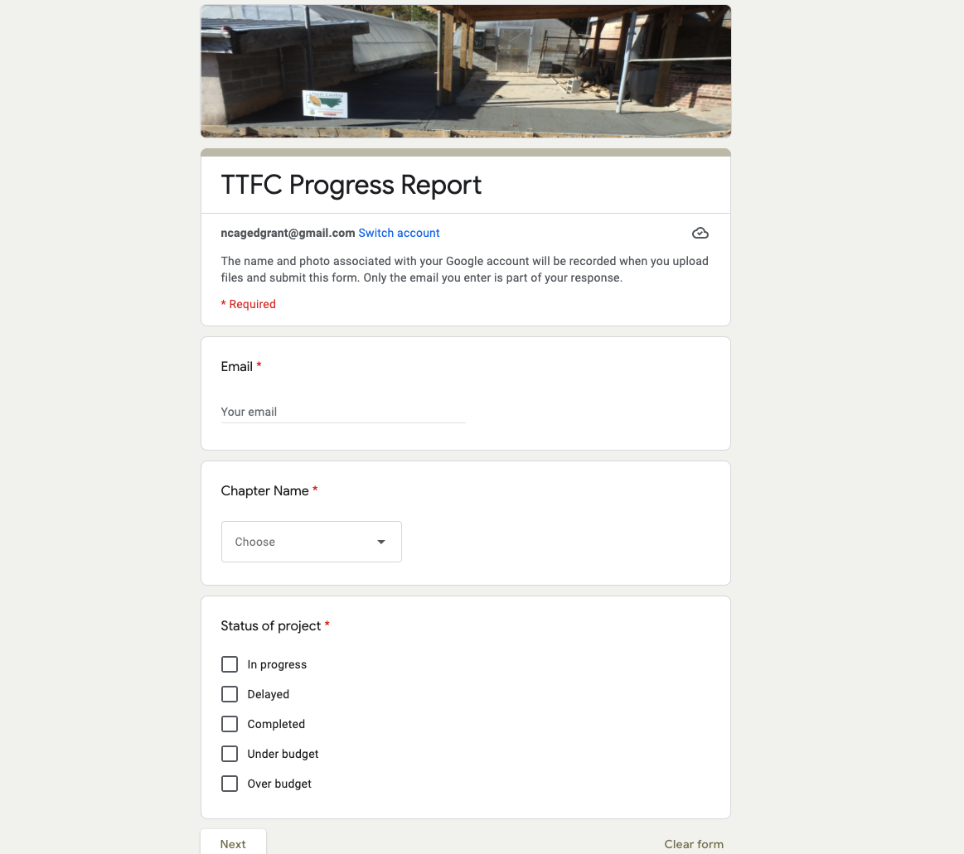
Progress Report

Slide 10
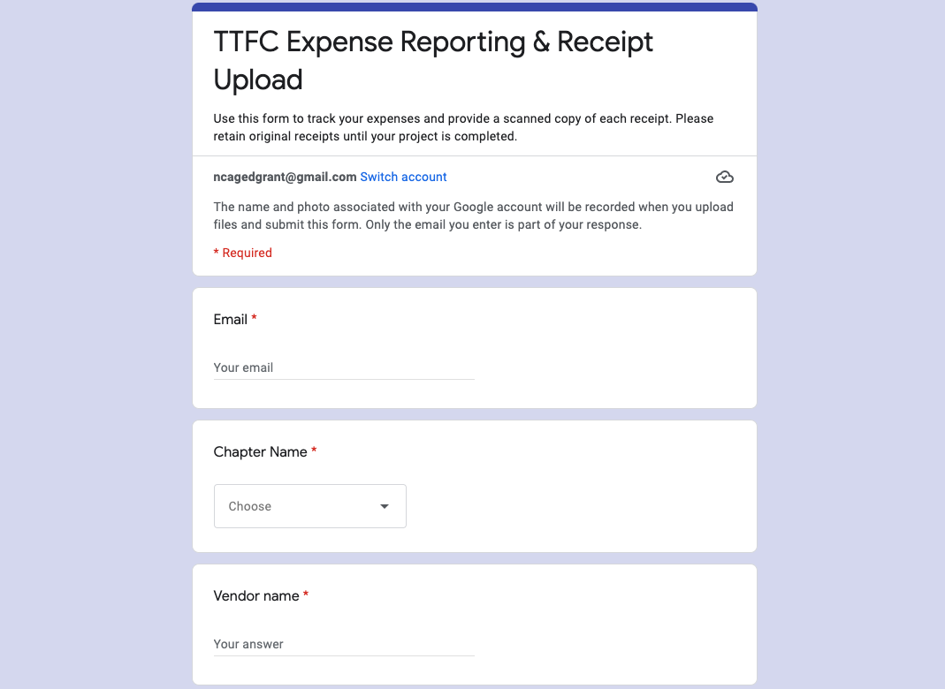
Financial Reporting

Slide 11
Required Final Video
Include the program name and the title of the project
Minimum of 20 photos and/or video clips
Include before, during, and after photos/videos
Include photos/videos of students performing work
Waivers in AET for all students

Slide 12
Signage
You will be provided at check presentation:
(1) Corrugated Lawn Signs with stakes
(2) 8 ½” x 11” Outdoor Stickers
(3) 3” x 5” Outdoor Stickers
Signs should be displayed permanently in locations that can be seen by the public.

Slide 13
Grant Changes
Minor changes can be made with approval of Joshua Bledsoe.
Do not contact the North Carolina Tobacco Trust Fund Commission about changes.

Slide 14
Questions?
Contact Joshua Bledsoe
joshua_bledsoe@ncsu.edu
(919) 513-1205
Contact Sherilee Deal
sdeal2@ncsu.edu
(704) 796-5736

